Slide 1

Ensuring Inclusion Through Eye Movements-based Bidirectional Feedback in Classrooms
Vijay Rajanna
Challenge #1: College of Engineering

Slide 2
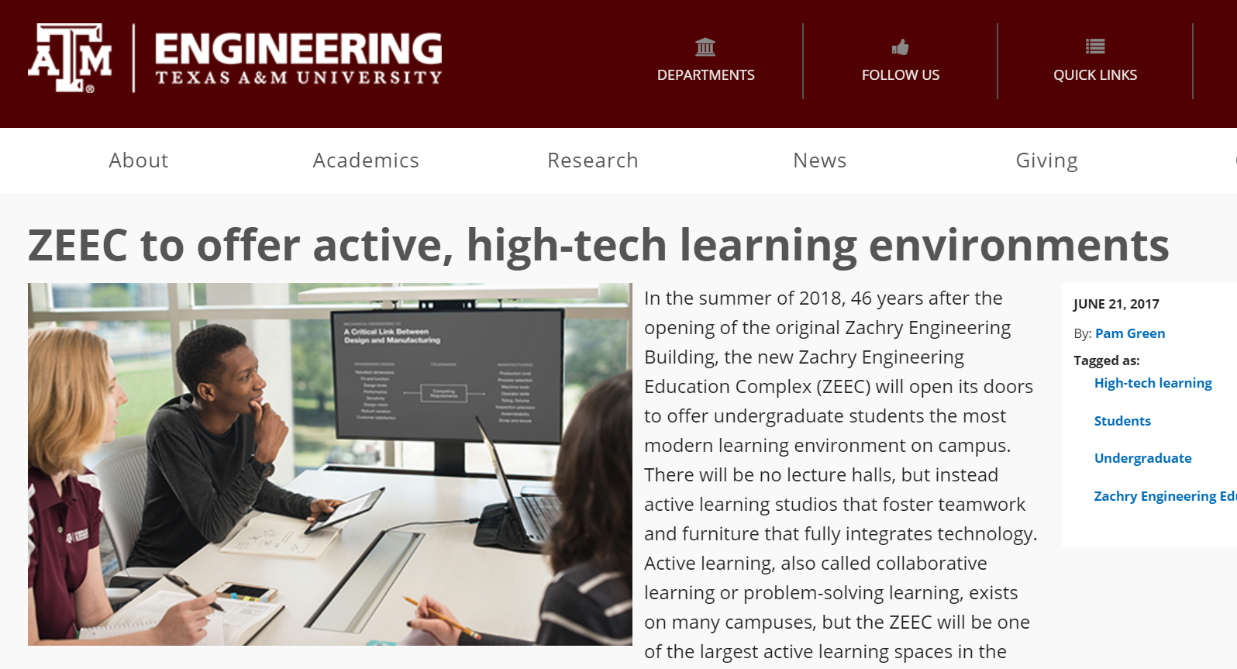
Proposed Solution

Slide 3
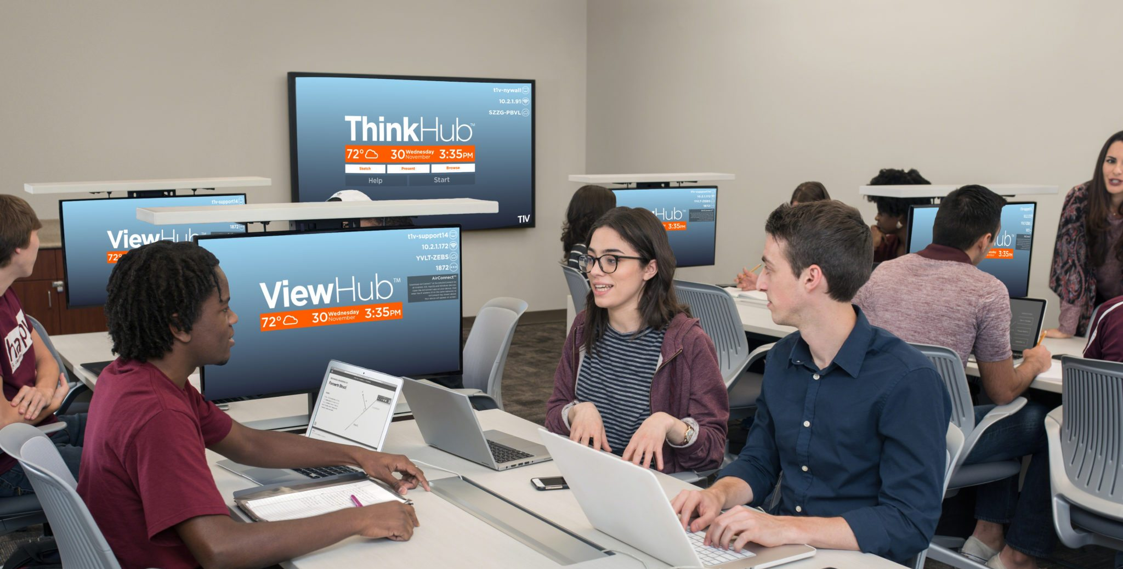
How?

Slide 4


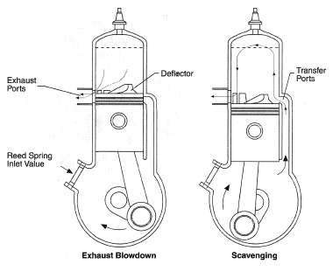

What`s Good?
How does two-stroke engine work?
Perry
Projector
Jerry
Professor
Larry

Slide 5
What`s the limitation?
Are students indeed looking at the diagram?
Well, I have to wait till the exam scores are out!!
Superbowl
Perry
Cat or Dog?
Jerry
2 Stroke Engine
Engine
Larry

Slide 6
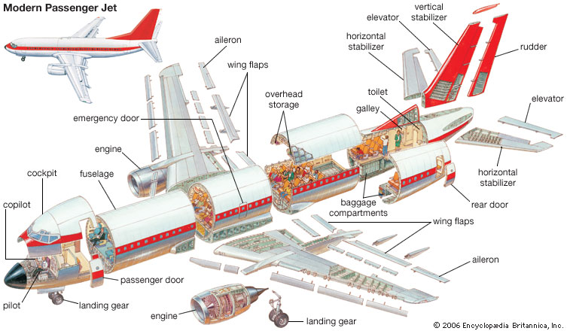
Complex Diagrams?

Slide 7
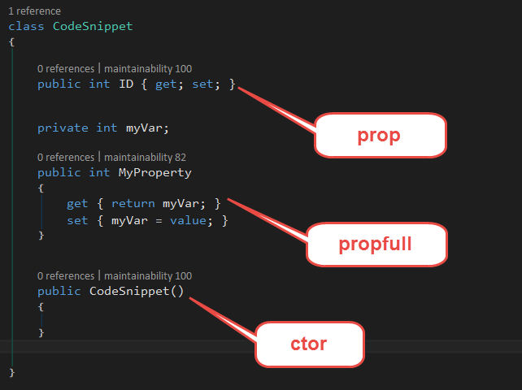
Code Snippet?

Slide 8
Problem?
The professor would never know if students are looking at the right locations? Or if they are looking at all?
Professor

Slide 9
Question? Can we use “SOME” technology to provide live feedback to the professor?

Slide 10
Are students looking at the screen at all? Are they looking at correct locations on the screen?

Slide 11
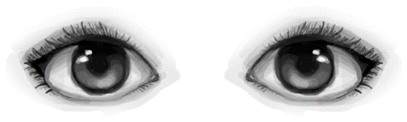
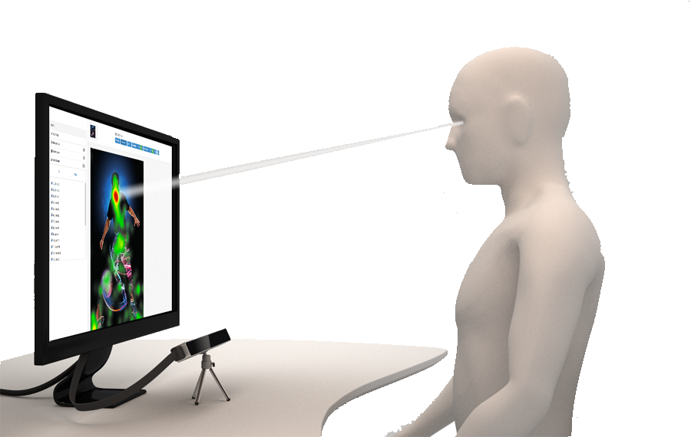
Solution
Using Eye Tracking to enable direct feedback

Slide 12
Case 1: The professor sees students' eye movements

Slide 13
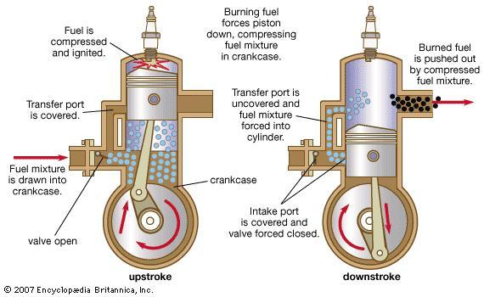

Slide 14
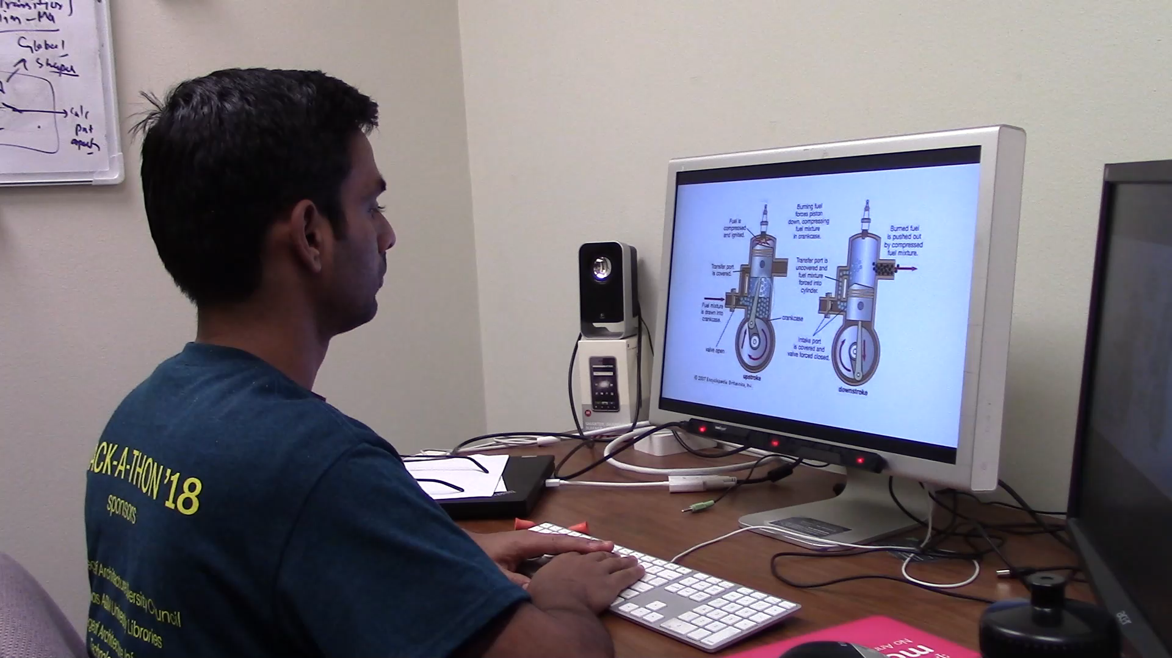

Slide 15
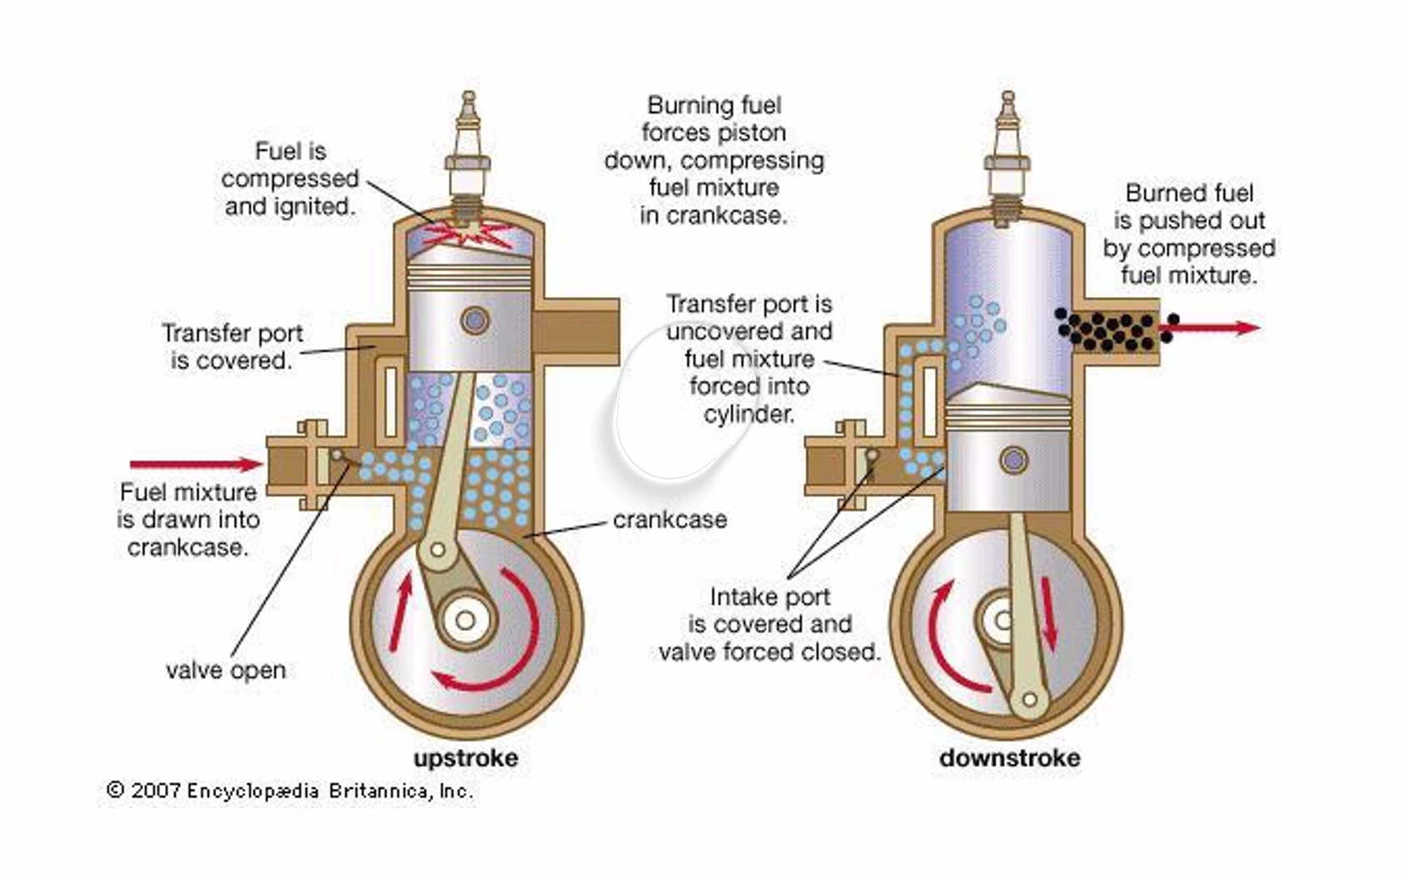

Slide 16
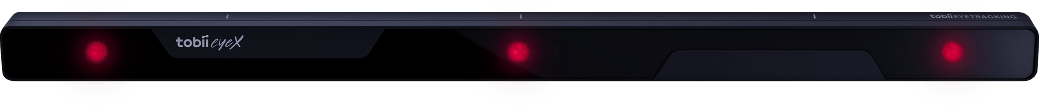
How does it work?
Professor’s Computer
Eye tracker
Larry
Projector
Students in sync with the instructor
Eye tracker
Perry

Slide 17
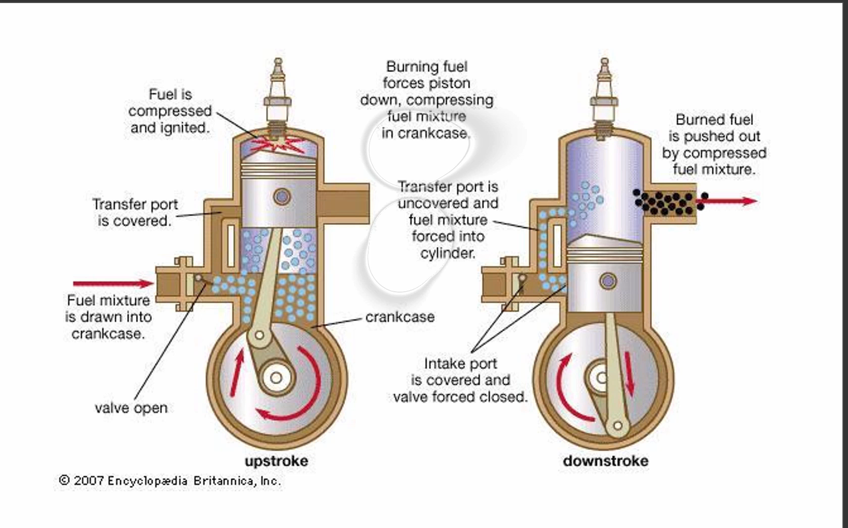

Slide 19
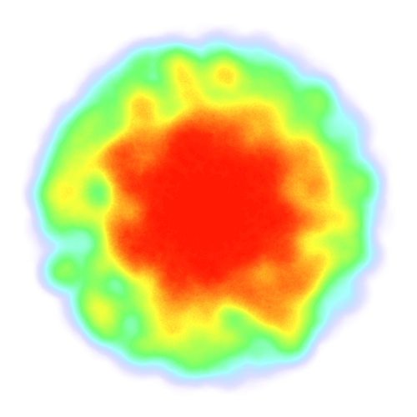

Slide 20
Teaching Coding
Larry
Let`s look at a property
Perry

Slide 21
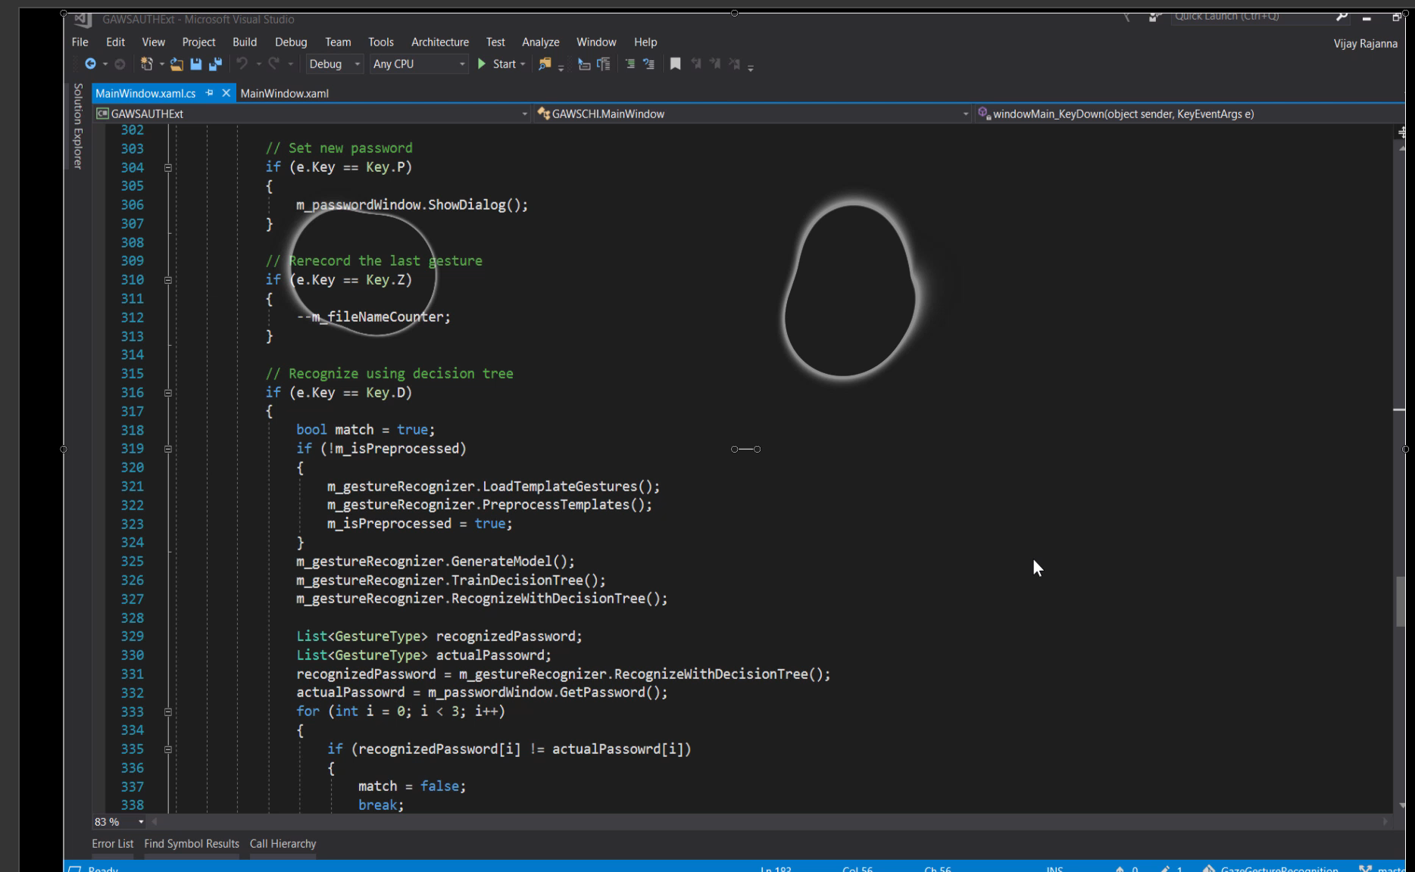

Slide 22
Report

Slide 23
Report

Slide 24
Case 2: Students could see the professor`s eye movements

Slide 25
Contextual Zooming For students with low vision

Slide 26
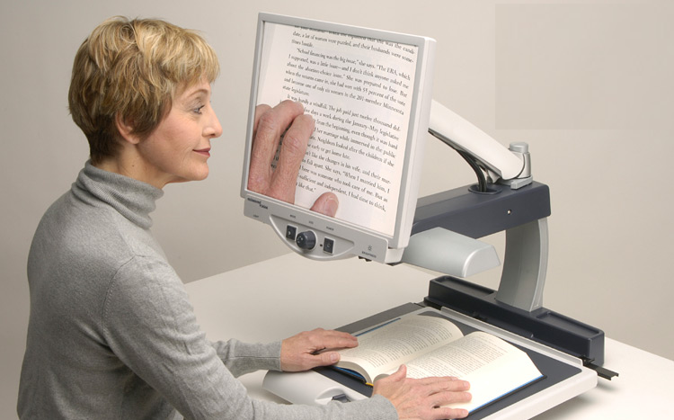

Slide 27
Larry
Perry

Slide 28
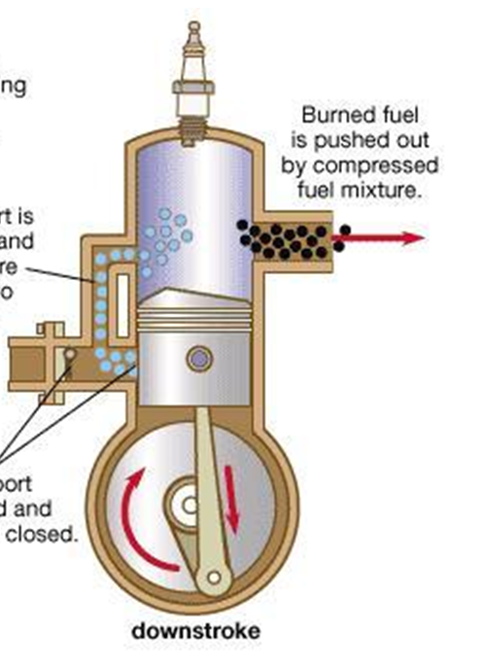
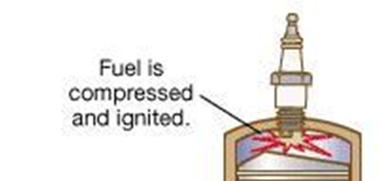
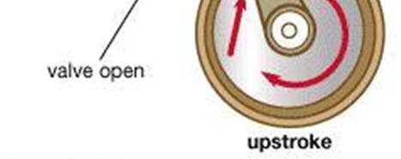

Slide 29
Thank you !!

Slide 30
How does it work?
Larry
Diverged Focus
Perry

Slide 31
How does it work?
Larry
Perry not even looking at the screen.
Perry

